Slide 1
Entity Framework
EF 6 Code First

Slide 2
Lesson Objectives
EF Code First Overview
Code-First Conventions
Database Initialization
Database Initialization Strategies
Seed data

Slide 3
EF Code First Overview
Section 1

Slide 4
EF Code First Overview
Do not have an existing database for your application?
Do not have much experience in SQL?
Do not want to working with SQL directly?
Prefer to writing entities and context class first?

Slide 5
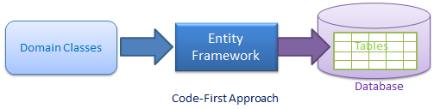
EF Code First Overview
Code-First is mainly useful in Domain Driven Design.
In the Code-First approach,
developer focus on the domain of application
create classes for domain entity
EF generate database from code

Slide 6
Code-First Workflow
Step 1: Create or modify domain classes
Step 2: Configure these domain classes using Fluent-API or data annotation attributes
Step 3: Create database using automated migration

Slide 7
Code-First Workflow
Loop:
Step 2.x: Add or update the domain classes
Step 3.x: Update database schema using code first migration
End loop

Slide 8
Code-First Conventions
Section 2

Slide 9
EF 6 Code-First Conventions
Conventions are sets of default rules which automatically configure a conceptual model based on domain classes when working with the Code-First approach.
Conventions are defined in the System.Data.Entity.ModelConfiguration.Conventions namespace.

Slide 10
EF 6 Code-First Conventions
Rules:
If no specification, use default convention
If define specification, use defined

Slide 11
Default code first conventions
Schema: EF creates all the DB objects into the dbo schema
Example: entity Student => dbo.Students
Table Name: plural form of the entity class name
Example: entity Student => table Students
Example: entity Category => table Categories

Slide 12
Default code first conventions
Primary key Name: EF will create a primary key column for the property named Id or <Entity Class Name> + "Id" (case insensitive)
Id
<Entity Class Name> + "Id“
If data type of the field (to be come primary key) is int, EF set Identity for the primary key, with seed is 1, increment step is 1

Slide 13
Default code first conventions
What happen if the entity class contains both?
Notes:
EF use Id column, then use <Entity Class Name> + "Id“ as a simple field

Slide 14
Default code first conventions
Foreign key property Name: EF will look for the foreign key property with the same name as the principal entity primary key name.
Use pair: public int CategoryID { get; set; }, public Category Category { get; set; }
SQL: CategoryID (FK, int, null)

Slide 15
Default code first conventions
If the foreign key property does not exist, then EF will create an FK column in the Db table with <Dependent Navigation Property Name> + "_" + <Principal Entity Primary Key Property Name>
Use only: public Category Category { get; set; }
SQL: Category_ID(FK, int, null)

Slide 16
Default code first conventions
Null column: EF creates a null column for all reference type properties and nullable primitive properties
Example: string, class type property
Not Null Column: EF creates NotNull columns for Primary Key properties and non-nullable value type properties
Example: int, float, decimal, datetime
To create null column for int, float, decimal, … use Nullable or ?
Example: Nullable<int> or int?

Slide 17
Default code first conventions
DB Columns order:
EF will create DB columns in the same order like the properties in an entity class.
However, primary key columns would be moved first.
Cascade delete
Enabled by default for all types of relationships.

Slide 18
Default code first conventions
Properties mapping to DB:
All public properties (with get and set) will map to the database.
Otherwise, the property will not mapped to the database

Slide 19
Default code first conventions
Examples:
public string Description { get; set; } => mapped
public string Description { get { return Name; } } => not mapped
public string Description { set { value = Name; } } => not mapped
public string Description; => not mapped
private string Description { get; set; } => not mapped
protected string Description { get; set; } => not mapped

Slide 20
Data type mapped
C# Data Type | Mapping to SQL Server Data Type | C# Data Type | Mapping to SQL Server Data Type
int | int | byte | tinyint
string | nvarchar(Max) | short | smallint
decimal | decimal(18,2) | long | bigint
float | real | double | float
byte[] | varbinary(Max) | char | No mapping
datetime | datetime | sbyte | No mapping (throws exception)
bool | bit | object | No mapping

Slide 21
Relationship Convention
EF 6 infers the One-to-Many relationship using the navigation property by default convention.
EF 6 does not include default conventions for One-to-One and Many-to-Many relationships.
You need to configure them either using Fluent API or DataAnnotation.

Slide 22
Conventions for One-to-Many Relationships
Convention 1:
includes a reference navigation property of parent in the child entity class
Convention 2:
includes a collection navigation property of children in the parent entity class
Convention 3:
includes navigation properties at both ends will also result in a one-to-many relationship
Convention 4:
a fully defined relationship at both ends will create a one-to-many relationship

Slide 23
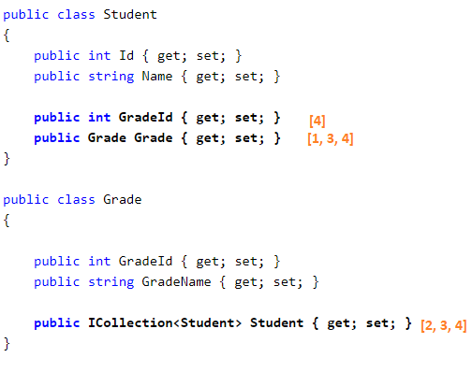
Conventions for One-to-Many Relationships

Slide 24
Database Initialization
Section 3

Slide 25
Database Initialization
Based on the parameter passed in the base constructor of the context class, EF decides the database name and server while initializing a database
The DbContext constructor overloading
No Parameter
string: nameOrConnectionString

Slide 26
No Parameter
If we do not specify the parameter in the base constructor of the context class, EF use DbContext class name as a connection string name
Create: public DbShopContext() : base()
Equals with: public DbShopContext() : base("DbShopContext")

Slide 27
Connection String Name
Define the connection string in app.config or web.config
Pass connection string name as a parameter of base constructor
DbContext class:
public DbShopContext() : base("DbShopContextConnectionString")
Web.config/App.config:
<add name="DbShopContextConnectionString" connectionString="....." providerName="System.Data.SqlClient"/>

Slide 28
Database Initialization
Start
Call constructor with connection string name?
Yes
Connection string name is existing in configuration file?
Yes
Check database is existing at connection?
Yes
Use existing database
No
No
No
Use context name as a connection string name
Create database at connection
Create database with the name matches to {Namespace}.{Context name} in local SQLEXPRESS

Slide 29
Database Initialization Strategies
Section 4

Slide 30
Database Initialization Strategies
CreateDatabaseIfNotExists
DropCreateDatabaseIfModelChanges
DropCreateDatabaseAlways
Custom DB Initializer
Disabled

Slide 31
CreateDatabaseIfNotExists
This is the default initializer.
It will create the database if none exists as per the configuration.
If the model class is changed then run the application with this initializer, then it will throw an exception.

Slide 32
DropCreateDatabaseIfModelChanges
If model classes (entity classes) have been changed
Drops an existing database
Creates a new database
We don't have to worry about maintaining database schema, when model classes change.
We may lost important data
Only use this strategy in development environment

Slide 33
DropCreateDatabaseAlways
Drops an existing database every time you run the application, irrespective of whether your model classes have changed or not.
This will be useful when we want a fresh database every time we run the application.
Only use this strategy in development environment

Slide 34
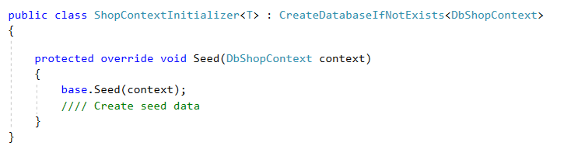
Custom DB Initializer
Create custom DB Initializer by inherit one of three strategy above
Usually used to apply configuration or create Seed data

Slide 35
Turn off the DB Initializer
When you are sure, the database is existing already.
When you don't want to lose existing data in the production environment
Working process:
Deploy stage: Initialize database, add Seed data
Test stage: Test application, update database (if need)
Product stage: Turn off the DB Initializer

Slide 36
Set an initializer in configuration
To change initializer without update code/re-deploy
Same code in difference environments: coding, testing, UAT, PROD, maintain
To detect/investigate problems

Slide 37
Set an initializer in configuration
Syntax:
<appSettings>
<add key=”DatabaseInitializerForType [MyAssemblyQualifiedContextType]” value=”[MyAssemblyQualifedInitializerType]” />
</appSettings>
Example:
<appSettings>
<add key=”DatabaseInitializerForType LazyUnicornTests.Model.BlogContext, LazyUnicornTests” value=”LazyUnicornTests.Model.BlogsContextInitializer, LazyUnicornTests” />
</appSettings>

Slide 38
Set an initializer in configuration
The entry goes in the appSettings section of configuration file
The key must always start with the string “DatabaseInitializerForType” followed by whitespace
…

Slide 39
Set an initializer in configuration
The second part of the key is the assembly-qualified name of the context type for which the initializer should be set
The value is the assembly-qualified name of the initializer to set, which must expose a public, parameterless constructor so that EF can create an instance of it

Slide 40
Turn off the DB Initializer
<appSettings>
<add key="DatabaseInitializerForType SchoolDataLayer.SchoolDBContext, SchoolDataLayer"
value="Disabled" />
</appSettings>
Value can be: Disabled or empty string

Slide 41
Seed Data
Section 5

Slide 42
Seed Data
To insert data into database tables during the database initialization process.
Use to provide some test data for the application
Use to create some default master data for the application

Slide 43
Seed Data steps
Step 1: create a custom DB initializer
public class ShopContextInitializer<T> : CreateDatabaseIfNotExists<DbShopContext>
Step 2: override the Seed method
protected override void Seed(DbShopContext context)
Step 3: don’t forget call the base Seed
base.Seed(context);
Step 4: add code to add data

Slide 44
Summary
Use EF Code First approach: create entities class and DbContext first, then generate database
Code-First Conventions: EF uses conventions to create database, tables, columns
There are strategies to create database
Always consider to use appropriate strategy

Slide 45

Thank you

